Slide 1
ER-to-Relational Mapping
Very important!!!!!!!

Slide 2
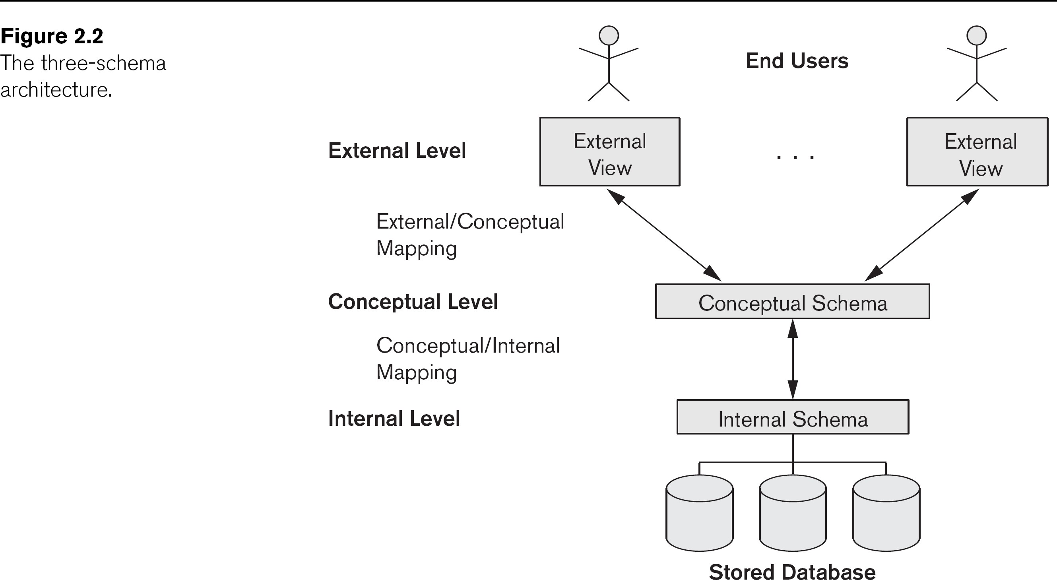
Data Model

Slide 3
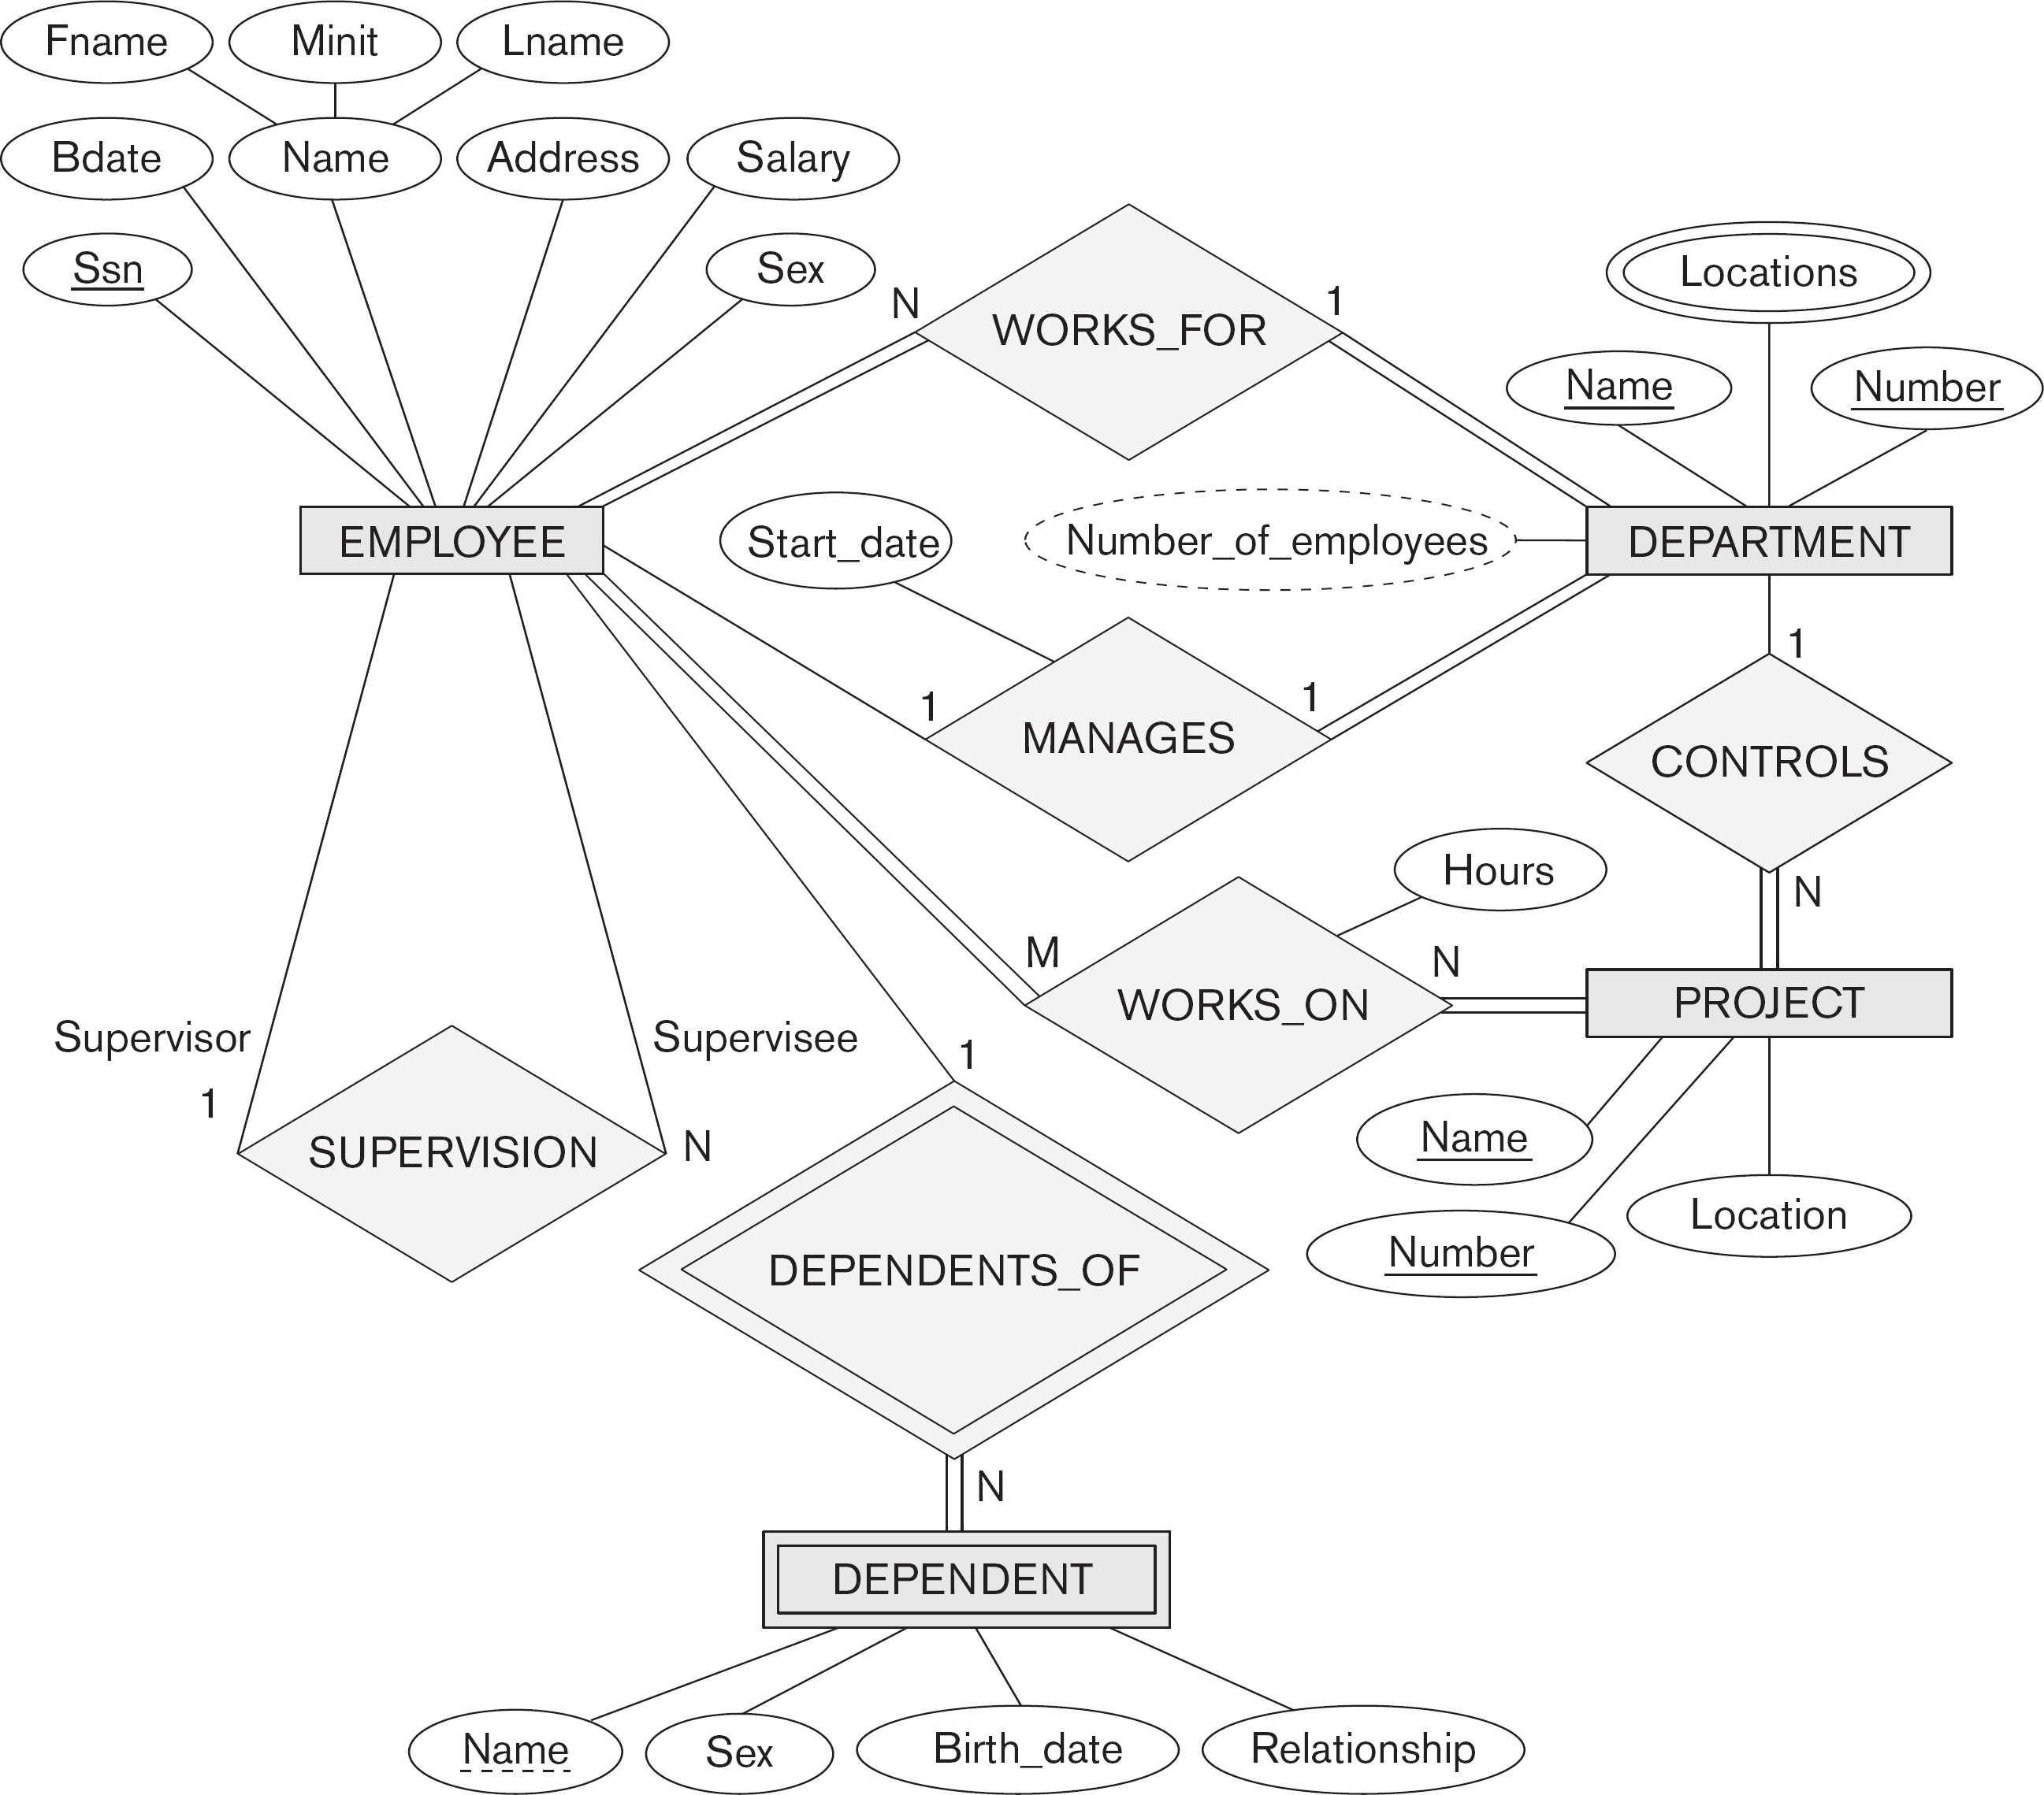
Example of ER - diagram

Slide 4
Step 1: Regular Entity Types
For each regular/strong entity type, create a corresponding relation that includes all the simple attributes (includes simple attributes of composite relations)
Choose one of the key attributes as primary
If composite, the simple attributes together form the primary key
Any remaining key attributes are kept as secondary unique keys (these will be useful for physical tuning w.r.t. indexing analysis)

Slide 5
Example of ER - diagram

Slide 6
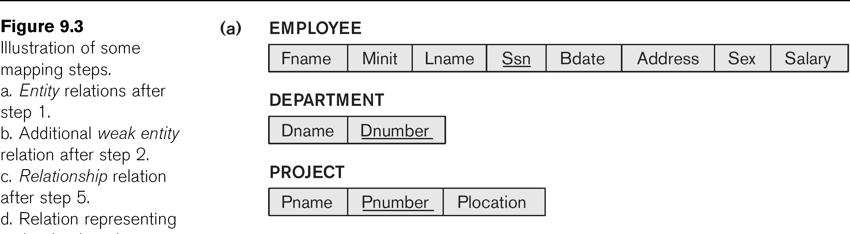
Step 1 Result

Slide 7
Step 2: Weak Entity Types
For each weak entity type, create a corresponding relation that includes all the simple attributes
Add as a foreign key all of the primary key attribute(s) in the entity corresponding to the owner entity type
The primary key is the combination of all the primary key attributes from the owner and the partial key of the weak entity, if any

Slide 8
Example of ER - diagram

Slide 9
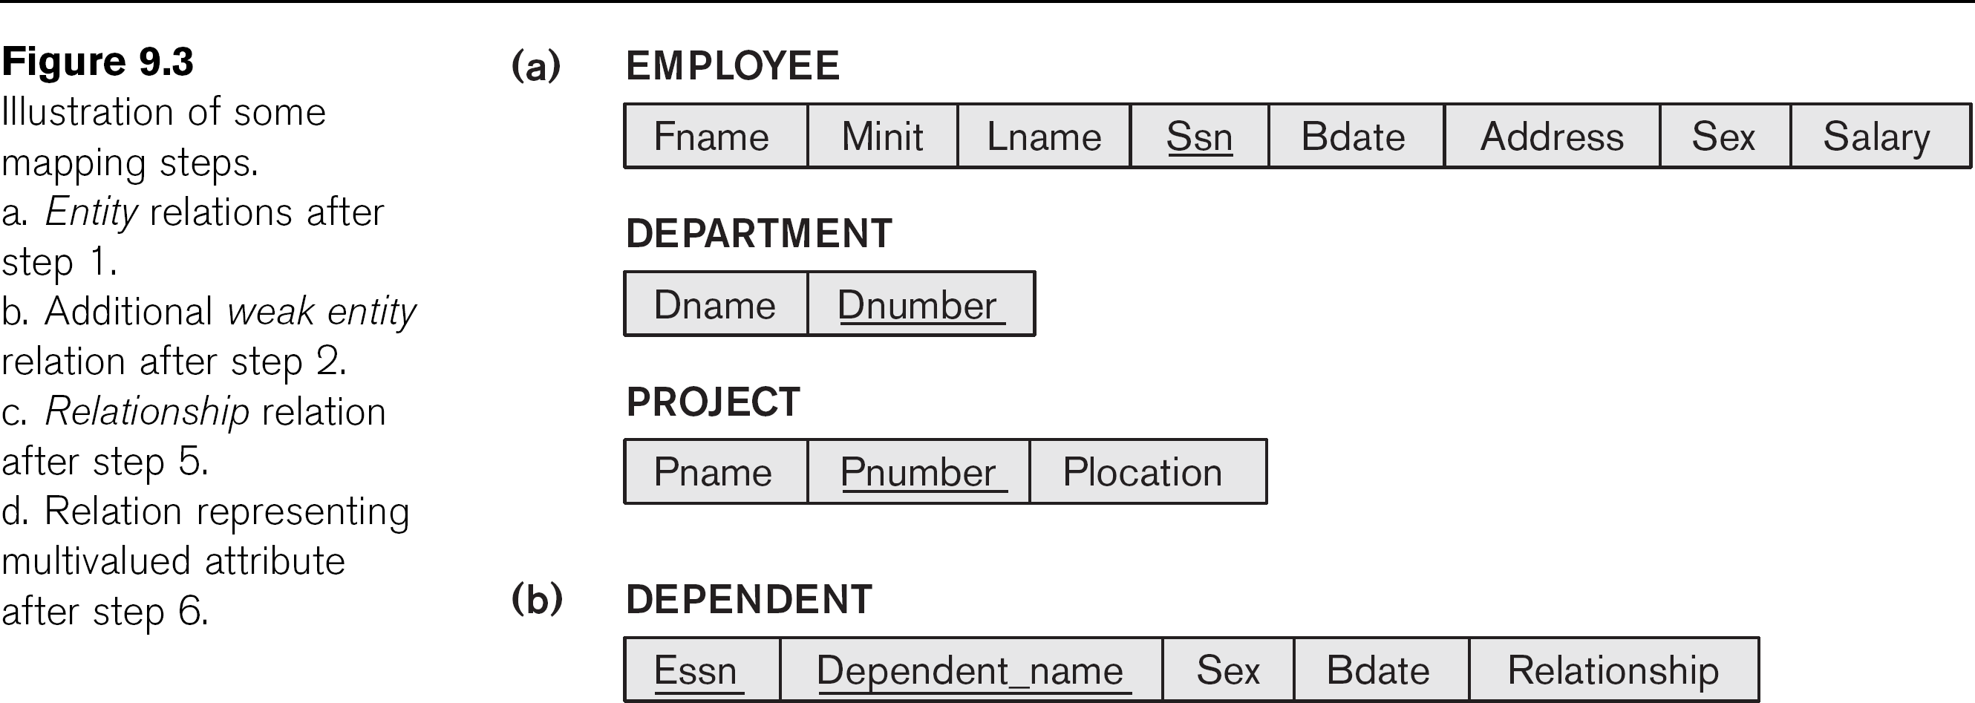
Step 2 Result

Slide 10
Step 3: Mapping Binary 1-to-1
Three approaches
Foreign Key
Usually appropriate
Merged Relation
Possible when both participations are total
Relationship Relation
Not discussed

Slide 11
Step 3: Mapping Binary 1-to-1
Foreign Key
Choose one relation as S(dept), the other T(employee)
Better if S(dept) has total participation (reduces number of NULL values)
Add to S(dept) all the simple attributes of the relationship
Add as a foreign key in S(dept) the primary key attributes of T(employee)

Slide 12
Example of ER - diagram

Slide 13
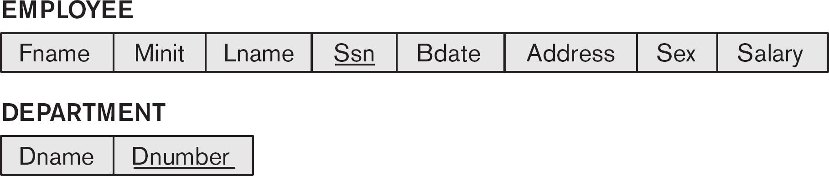
Step 2 Result

Slide 14
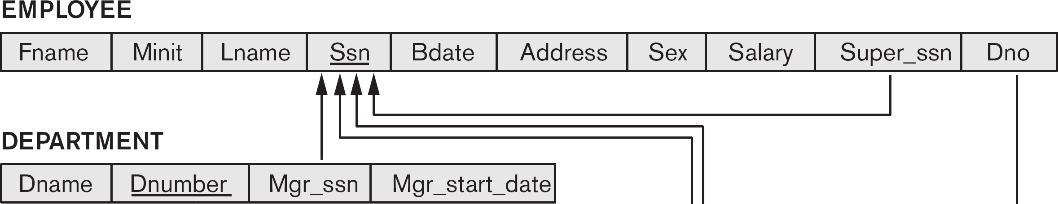
Step 3 Result

Slide 15
Step 4: Binary 1-to-N
Choose the S(project) relation as the type at the N-side of the relationship, other is T(dept)
Add as a foreign key to S(project) all of the primary key attribute(s) of T(dept)
Another approach: create a relationship relation

Slide 16
Example of ER - diagram

Slide 17
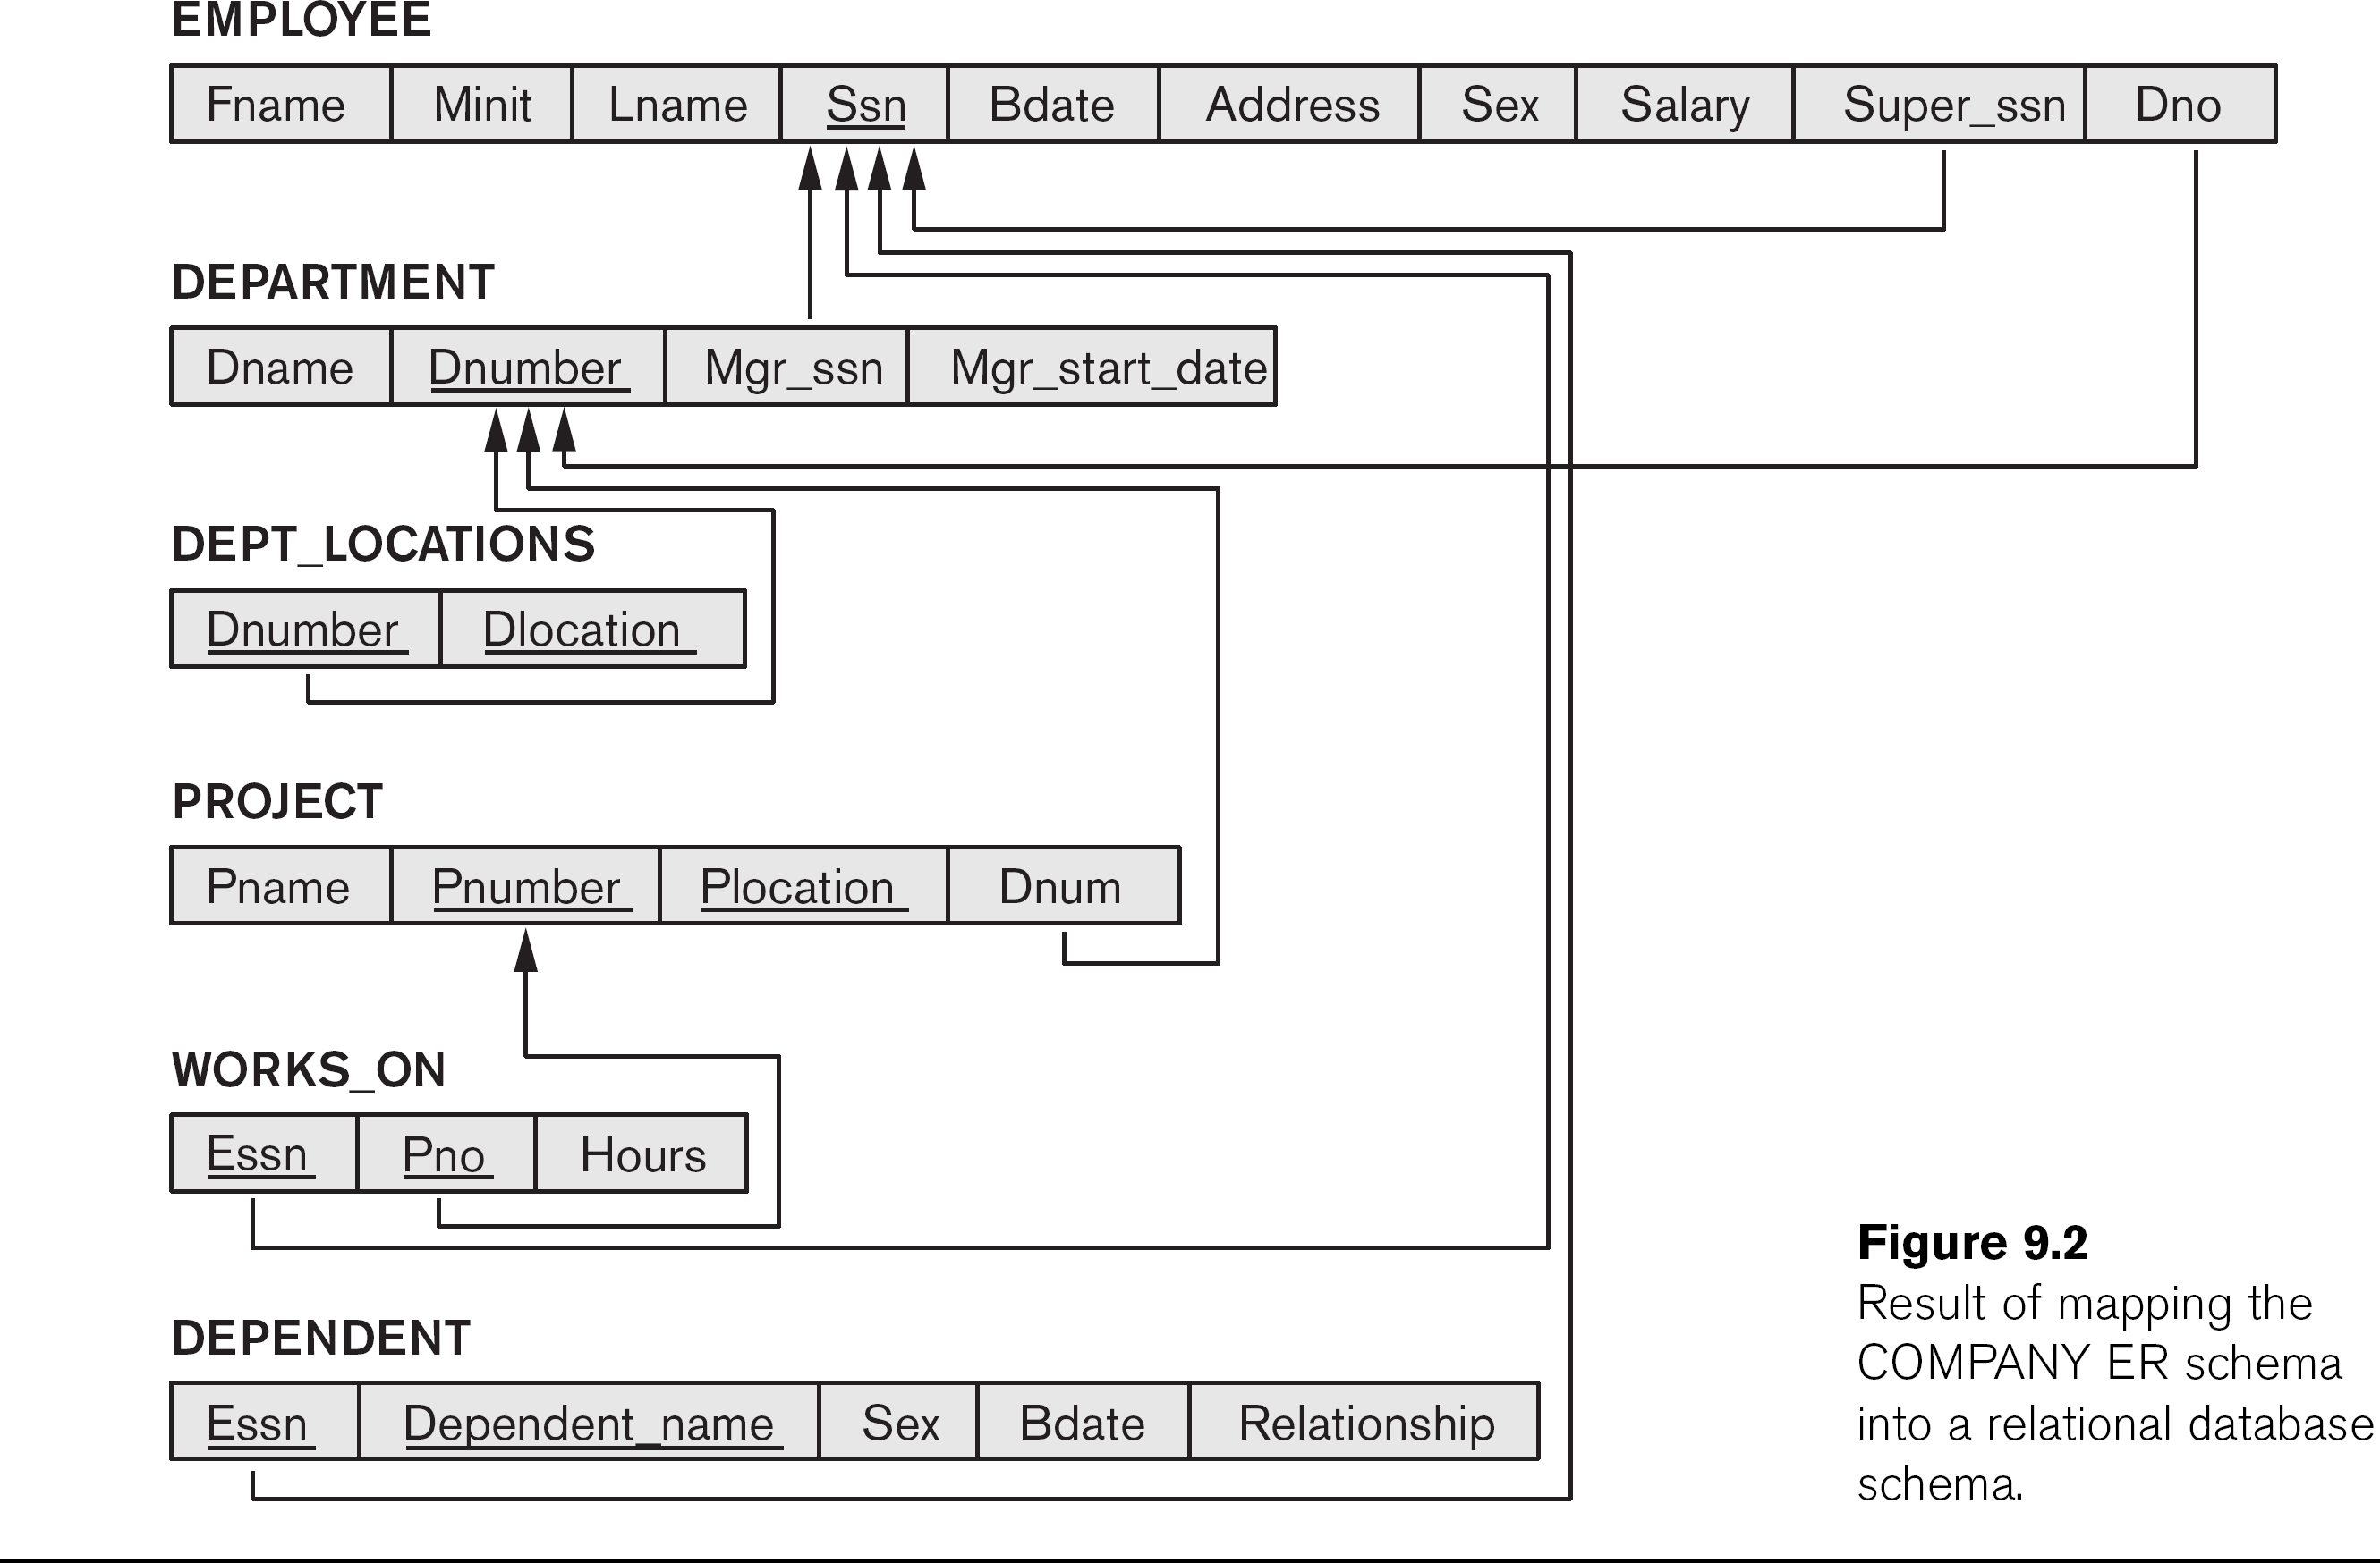
Step 4 Result

Slide 18
Step 5: Binary M-to-N
Create a new relation S (termed: relationship relation)
– In some ERD dialects, actually drawn in.
Add as foreign keys the primary keys of both relations; their combination forms the primary key of S
Add any simple attributes of the M:N relationship to S

Slide 19
Example of ER - diagram

Slide 20
Step 5 Result

Slide 21
Step 6: Multivalued Attributes
Create a new relation S(location)
Add as foreign keys the primary keys of the corresponding relation
Add the attribute to S(location) (if composite, the simple attributes); the combination of all attributes in S(location) forms the primary key

Slide 22
Example of ER - diagram

Slide 23
Step 6 Result

Slide 24
Step 7: Specialization/Generalization (As of Now Ignore)
Multiple relations – subclass and superclass
Usually works (assumes unique id at parent)
Multiple relations – subclass only
Should only be used for disjoint
Single relation with one type attribute
Only for disjoint, can result in many NULLs
Single relation with multiple type attributes
Better for overlapping, could be disjoint

Slide 25
Summary
Mapping from ERDs to relations is an algorithmic process
Some choice points involve comparing time-space tradeoffs (more in physical design)
The ER diagram may change from people to people depending on their understanding.

